Slide 1
Abusive Relationships
Teen Dating Violence

Slide 2
Dating Violence:
The use of harassing, controlling, and/or abusive behavior to maintain power and control over a partner.
Anyone can be a victim regardless of age, race, or gender.

Slide 3
Physical Abuse
The act of someone physically hurting you, such as by hitting you or throwing something at you.
Examples:
Shoving
Punching
Slapping
Hitting
Kicking
Hair pulling
Strangling

Slide 4
Verbal & Emotional Abuse
Calling you names, insults you
Isolation
Harassment
Jealousy
Belittling you
Threatening to hurt you, a family member, himself/herself if you don’t do what he/she wants
Making you feel like your opinions, actions and feelings are wrong and unimportant

Slide 5
Sexual Abuse
Sexual abuse is when someone forces you into unwanted sexual activity, especially through threats or coercion.
Kissing
Touching
Oral, Anal, Vaginal
Not taking or using birth control

Slide 6
Technological Abuse
Verbal/Emotional abuse by use of cell phones, internet

Slide 7
Dating Violence Cycle
Tension – such as criticism, yelling, swearing, angry gestures, coercion, or threats
Violence – such as physical and sexual attacks or threats
Seduction – such as apologies, promises to change, or gifts

Slide 8
Jealousy and possessiveness are two of the most common warning signs of dating abuse. Abusers use them to control the other person's behavior.
The elements listed below can keep the cycle in motion.
Love for the abuser: Believing that the relationship is not entirely bad
Hope: Thinking things will change or it's just a phase
Fear: Worrying that threats will become a reality, resulting in fear of ending the relationship

Slide 9
Myths of Dating Violence
Many people in abusive relationships are in denial. They cling to the myths:
That their partner will never do it again.
That they are not being abused.
That they will leave when the time is right.
That it only happens to girls.

Slide 10
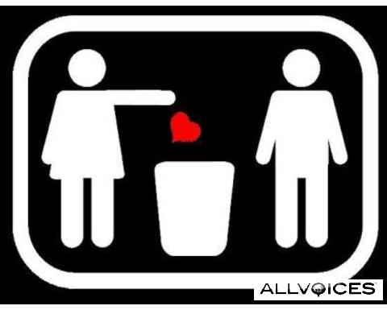
Ending Relationships
Think about what you are going to say in advance
Choose a public place if safety is a concern
Say it in person and do it yourself
(if safety is a concern, use phone, email)
Be respectful
Do not let emotions or guilt change your mind
Give the person space

