Slide 1
Reproductive Disorders Female

Slide 2
sterility
Not being able to get pregnant
Common causes for females:
Fallopian tube blockage
Ovulation disorders
Polycystic ovary syndrome
endometriosis

Slide 3
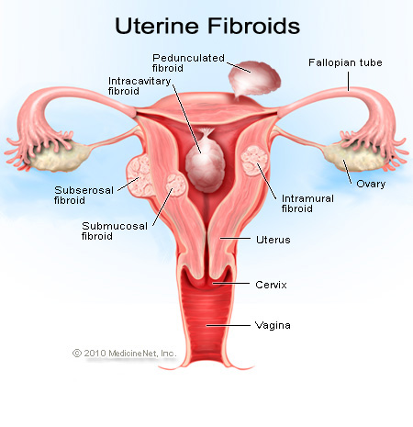
Fibroids
Non cancerous tumors found in uterus
Symptoms:
Excessive menstrual bleeding, pain, frequent urination

Slide 4
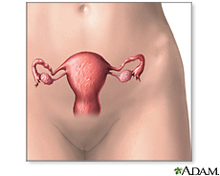
Fibroids are leading cause of
Hysterectomy: removal of the uterus, fallopian tubes and ovaries

Slide 5
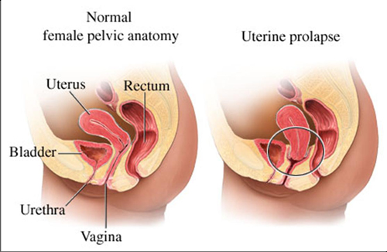
Uterine prolapse
uterus drops into the vagina due to weakening of pelvic floor due to pregnancy or age

Slide 6
Amenorrhea (uh-men-o-REE-uh)
Absence of menstruation
Pregnancy
Breast feeding
Menopause
Contraceptives
Stress
Weight loss
Excessive exercise

Slide 7
PID
Pelvic Inflammatory Disease
infection of the uterus, fallopian tubes and other reproductive organs that causes symptoms such as lower abdominal pain and unusual discharge.
It is a serious complication of some sexually transmitted diseases (STDs), especially chlamydia and gonorrhea.
PID can damage the fallopian tubes and tissues in and near the uterus and ovaries. PID can lead to serious consequences including infertility, ectopic pregnancy (a pregnancy in the fallopian tube or elsewhere outside of the womb), abscess formation, and chronic pelvic pain.
Treatment: antibiotics

Slide 8
HPV
Common STI
Caused by sexual contact, skin to skin, oral sex
Visible genital warts
Lead to cervical cancer

Slide 9
PMS
Premenstrual syndrome (PMS) refers to a wide range of physical or emotional symptoms that typically occur about 5 to 11 days before a woman starts her monthly menstrual cycle. The symptoms usually stop when menstruation begins, or shortly thereafter.

Slide 10
The most common physical symptoms include:
Abdominal fullness, gas
Bloating of the abdomen
Breast tenderness
Clumsiness
Constipation or diarrhea
Food cravings
Headache
Less tolerance for noises and lights

Slide 11
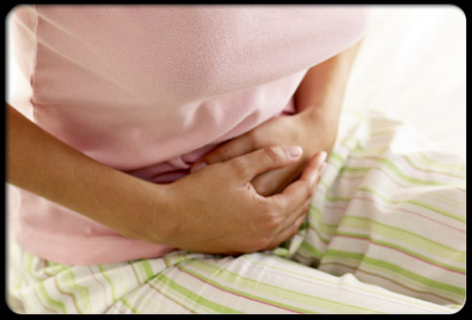
endometriosis
Endometriosis occurs when tissue normally found inside the uterus grows in other parts of the body. It may attach to the ovaries, fallopian tubes, the exterior of the uterus, the bowel, or other internal structures.
Symptoms
Pain before, after and during menstruation
Treatment:
Surgery, birth control pills

Slide 12
treatment
Surgery
Kegel exercises to strengthen pelvic floor – squeeze and contract vaginal muscles (ones that hold a tampon in place) for 10 seconds and release for 10 seconds

Slide 13
infertility
Not being able to become pregnant after one year of trying to conceive a child
Treatments:
Fertility drugs, surgery, artificial insemination, in vitrofertilization

Slide 14
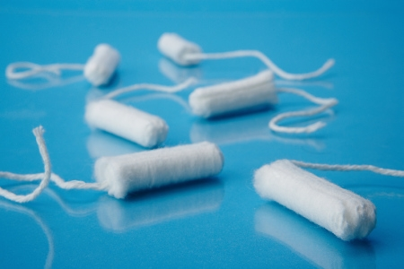
Toxic Shock Syndrome
Potentially fatal illness caused by bacteria
Caused by leaving tampons in for an extended time
Recommended to not leave in tampons overnight

Slide 15
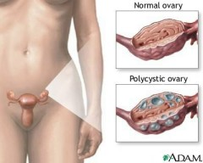
PCOS
Polycystic Ovary syndrome
Hormonal disorder
Small cysts on ovary
Treatment:
Regulate menstrual cycle
Surgery to ovary to induce ovulation

Slide 16
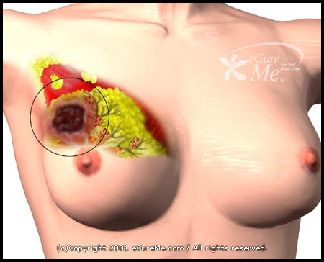
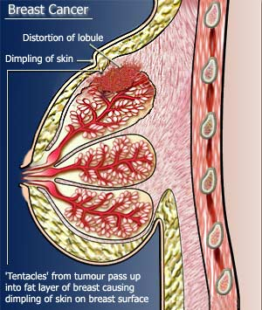
Breast Cancer
Cancer of ducts (move milk) or lobules (produce milk)

Slide 17
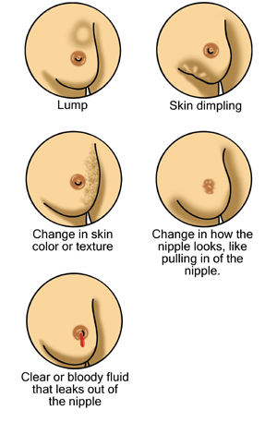
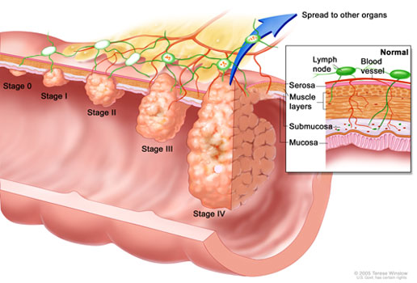

Slide 18
Breast cancer treatments
Radiation
Surgery
Lumpectomy removes the breast lump; Mastectomy removes all or part of the breast and possible nearby structures
Chemotherapy
Remember to examine breasts monthly!

